Slide 1
Technical Support
Student Name: Dhruv Pathak
Roll No.: E008 SAP ID: 70021018074
B Tech Division – E
TIP Organization: PBOPlus
Industry Mentor: Mr. Karunesh Jha
Faculty Mentor: Prof Mohini Reddy

Slide 2
Roadmap
Introduction
About the Organization
About the Department
Project Details
Learning and Experience
Comments and Future Plan

Slide 3
Introduction
Project Problem Definition
PBOPlus, a pioneer consulting firm in the field of business process management, offers services which include Industrial Automation, Robotics, and IoT.
Being manufacturing experts, the driving reason for leaders at PBOPlus to foray into Robotics was to diversify into the manufacturing domain. I was able to contribute for the organization and learn about the Robotics field and the industry standards and requirements.
I was required to learn Python and understand vision detection and how different techniques and execution takes place.
I was tasked to understand the Raspberry Pi and how different components can be used with it like camera, LEDs, gyroscopes, motion sensors etc.

Slide 4
About the Organization
PBOPlus’ aim is to help our customers achieve reduction in business costs and increase in value for their clients thereby increasing profitability and/or business growth.
We reduce departmental silos within organizations through cross-functional processes and horizontal organizational structure changes that leads to increased customer alignment and improved organizational effectiveness.
Automation and Robotics have become key integrations as doing so, we were able to further align ourselves with the organization’s vision of helping businesses to stay free of repetitive tasks and focus on profitability.

Slide 5
About the Department
The main purpose of an industrial robot is to replicate human motions/actions. Specific industrial functions require very high levels of precision or repeatability.
We are supported by extensive knowledge of how the manufacturing industry operates. We understand the intricacies of:
• How to place a factory?
• How to run a factory smoothly?
• What parts need to be produced in-house and what needs to be outsourced?
The ‘Robotics and Automation’ department headed by Mr. Karunesh Jha aim to provide the best solutions and high efficiency for clients. We aim to reduce labor and had automation for increase in revenue and help achieve greater production rates.

Slide 6
Project Details
Learning Python and understanding Vision Detection
Understanding and connecting the Raspberry Pi 3 B+
Part 1: LED Control with GUI
Part 2: Face Detection
Part 3: Security System
Part 4: Gyroscope System

Slide 7
Understanding Raspberry Pi 3 B+

Slide 8
Connecting the Raspberry Pi
Enable SSH and Install XRDP for Remote Command Line and GUI access respectively.

Slide 9
GPIO Pins

Slide 10
Part 1: Smart Lights (LEDs)
Basic LED module connected to a Raspberry Pi can easily control the status (ON / OFF) of the LED, its behaviors (BLINKING) and its illumination (BRIGHTNESS) from simple code. These help in Smart IoT Lights implementation.

Slide 12
Part 2: Face Detection (Camera Module)
The aim of this part is to connect the camera module to capture pictures and detect the no. of faces. The execution is done using Haar Cascade methodology. Using the haarcascade_frontalface_default.xml, we will attempt to detect the faces of persons in this use-case

Slide 13
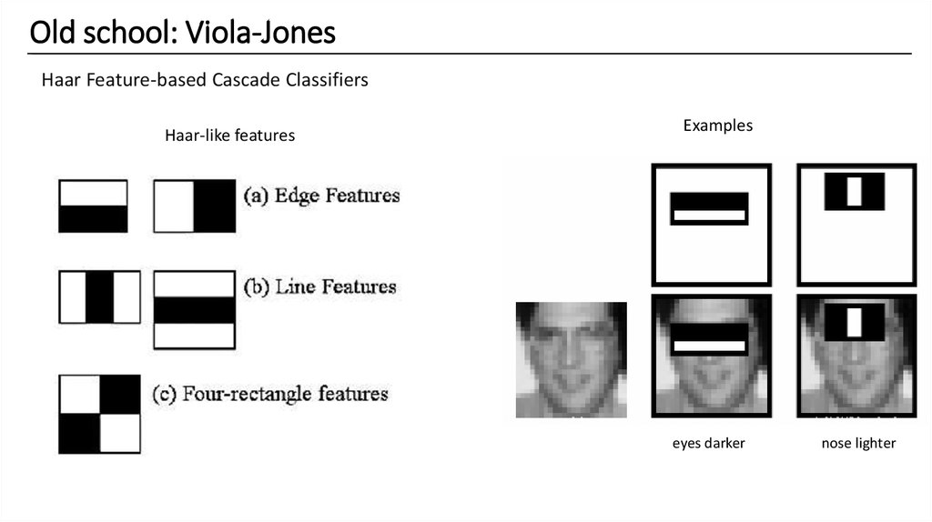
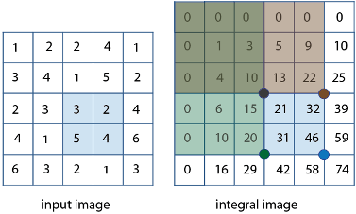
Haar-Cascade Methodology

Slide 14
Part 3: Security System (PIR Motion Sensor)
With the help on a camera and a motion sensor connected to a Raspberry Pi, it is possible to capture images when motion is detected. These systems act as security systems to help prevent from theft and burglary.

Slide 15
Part 4: Gyroscope System
The MPU6050 is a Micro Electro-Mechanical Systems (MEMS) with a three-axis accelerometer and three-axis gyroscope. This allows us to measure a system's or object's acceleration, velocity, direction, displacement etc.

Slide 17
Development Cycle

Slide 18
Learning and Experience
After the completion of my 8 weeks internship tenure, I have learnt basic Python and Vision Detection concepts. I have also gained insights about the working and use of the Raspberry Pi with different components as addition.
The technical internship at PBOPlus Ltd has been a professionally satisfying experience. The opportunity helped me to greatly expand my knowledge base and gain insights about working in the Robotics domain. It enabled me to interact with individuals displaying profound intellect and professionalism.
Work from Home has been a challenge for me during the internship because of the work including hardware but being able to maximize my output has also been a challenge I have learnt from.

Slide 19
Comments and Future Scope
After the completion of my TIP internship tenure, I have understood how different groups and roles integrate together to deliver the final required task.
These mini projects and components of actual complex robotic machines. Therefore, to incorporate and combine all these small modules together to form a better and more reliable integrated machine will be an advancement and future scope.
Also, to upgrade the sensors to the ones with high precision and accuracy is a must. This adds more reliability and gives more control to the programmer to achieve the required targets through these projects.
This internship has led me to integrate hardware in my next project with higher complexity.

Slide 20
THANK YOU !

Slide 21
Questions ?

